Slide 1


Introduction
ACCESSDATA® FORENSICS
The Recycle Bin
Forensic Analysis
Incident Response
eDiscovery
Information Assurance

Slide 2
Module Objectives
XP Recycle Bin
  Functionality
  Folder and contents
  FAT vs. NTFS differences
INFO2 Structure
  “Deleted” file path
  “Deleted” file index number
  “Deleted” file drive location
  “Deleted” file date and time
  “Deleted” file physical size
Forensic Implications
  Files deleted or removed / emptied bin
  Recovering deleted INFO2 information

Slide 3
Recycle Bin – Functionality
Deleting files
Tracks only user-deleted files
  Right-click
  Drag-and-drop
Does not track operating system
  Deleting temporary Internet files
  Deleting things with a Shift+Delete
No removable media or networks
Machine Active Time Bias is relative

Slide 4
Recycle Bin – FAT vs. NTFS
FAT
280-byte INFO2 records (there are OS exceptions here)
All users on machine can access files
NTFS
800-byte INFO2 records
User-specific file access based on SID

Slide 5
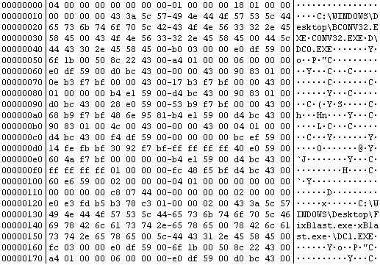
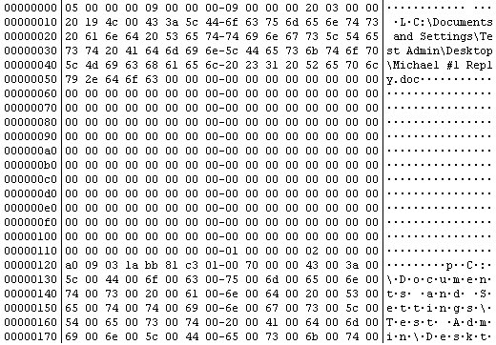
Recycle Bin – FAT vs. NTFS
FAT NTFS

Slide 6


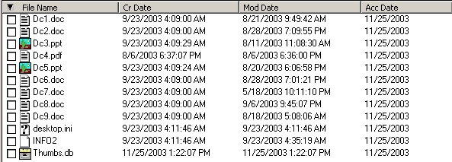
Recycle Bin – Folder contents

Slide 7
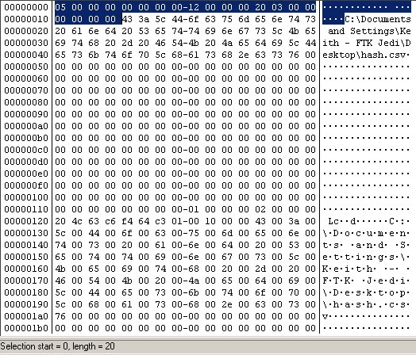
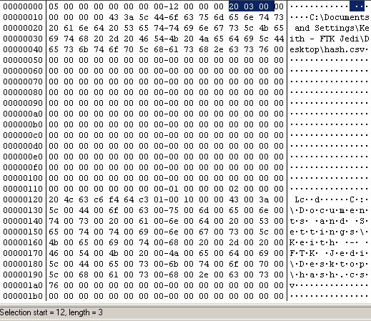
INFO2 – Header
Offsets 0-19 of the INFO2 file
Offsets 12-15 of the INFO2 file (record size)

Slide 8
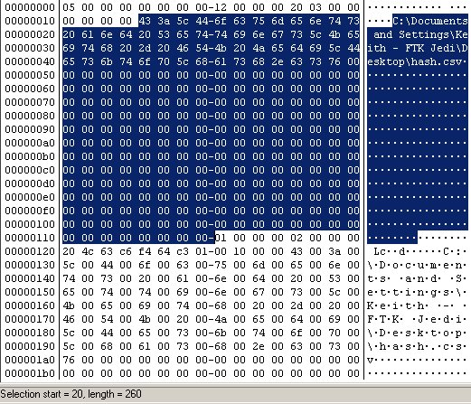
INFO2 – Deleted file path
Offsets 0-259 of INFO2 record
Accommodates an entire LFN
File restoration

Slide 9
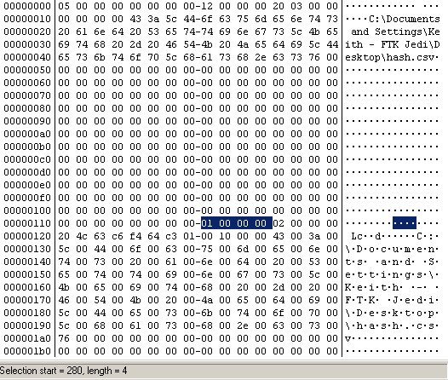
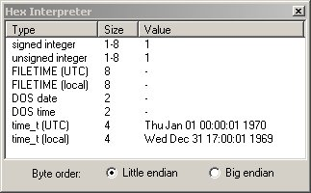
INFO2 – Deleted file index
Offsets 260-263 of INFO2 record
Links record to placeholder
Hex conversion

Slide 10
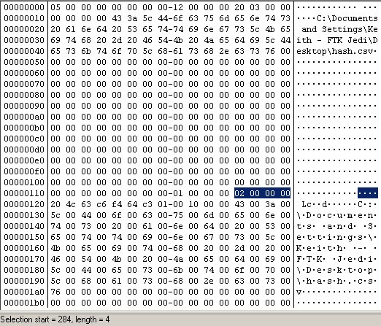
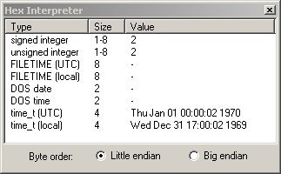
INFO2 – Deleted file drive
Offsets 264-267 of INFO2 record
Drive letter file originated from
Hex conversion

Slide 11
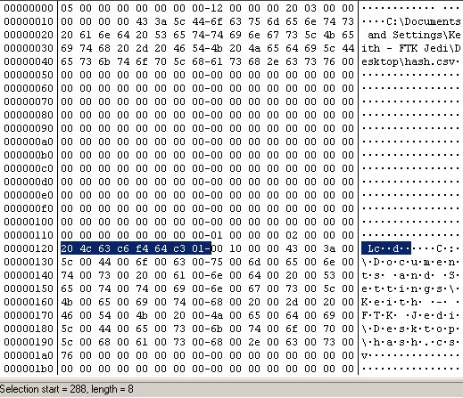
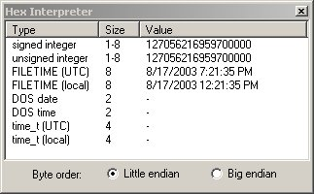
INFO2 – Deleted file date & time
Offsets 268-275 of INFO2 record
When file was placed in the bin
Hex conversion

Slide 12
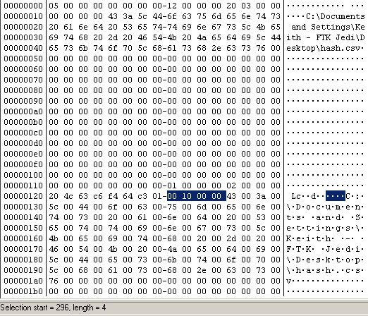
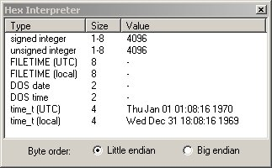
INFO2 – Deleted file physical size
Offsets 276-279 of INFO2 record
File’s physical size (cluster relative)
Hex conversion

Slide 13
Implications
Files vs. Folders
Removed from Bin ?
The [Orphan] Folder
Emptying the Bin – When ?
Unallocated INFO2 – Recovery ?
  dtSearch Recognition
  Regular Expression Searching

Slide 14
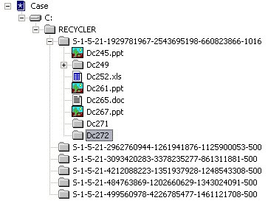
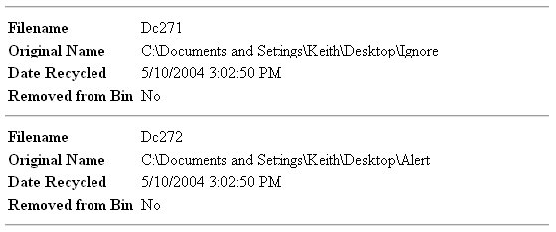
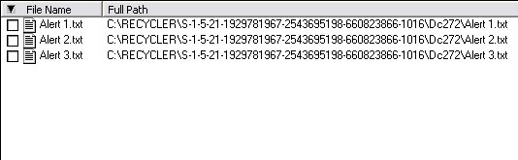
Files vs. Folders
INFO2

Slide 15
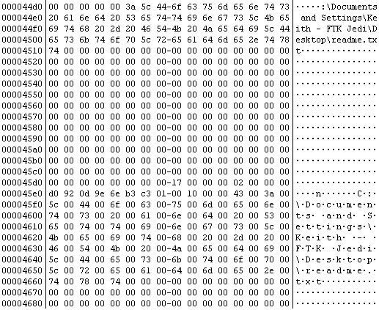
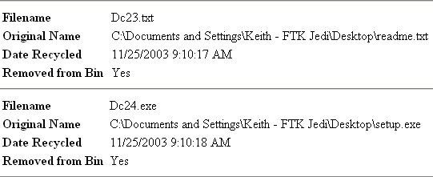
Removed from Bin
Data still in INFO2
Date / Time also !

Slide 16
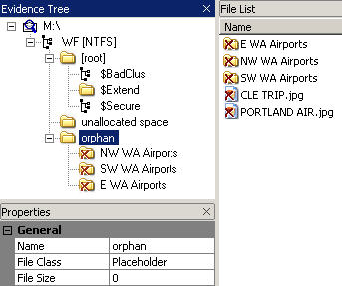
The [Orphan] Folder
NOTE: The Orphan folder is created by FTK Imager and FTK to display recovered, orphaned files and folders

Slide 17

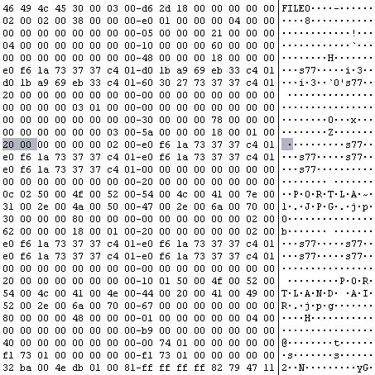
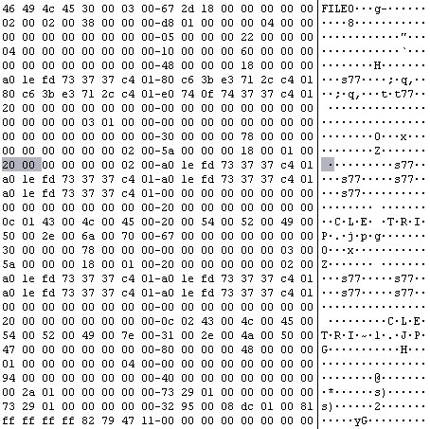
The [Orphan] Folder
Parent Record – Header – sequence #
Parent record sequence number does not match the child record sequence number reference

Slide 18

The [Orphan] Folder
Parent Record – Header (allocation byte)
Q: What can
change the
sequence #?
A: Changing the
allocation
status!
Hex | Binary | File or Folder | Deleted or Allocated
00 | 0000 0000 | File | Deleted
01 | 0000 0001 | File | Allocated
02 | 0000 0010 | Folder | Deleted
03 | 0000 0011 | Folder | Allocated

Slide 19
The [Orphan] Folder
In other words …
Sequence numbers match | Parent record allocated | File = Child
Parent sequence number = +1 | Parent record unallocated | File = Child (Deleted)
Parent sequence number = +1 or more | Parent record allocated | File = Orphan
FTK determines this through an algorithm to ensure proper data integrity

Slide 20
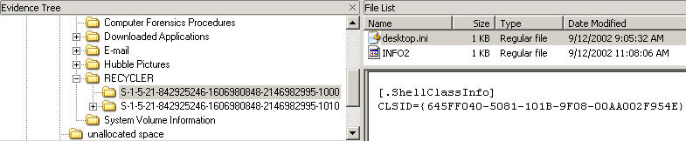

Emptying the Bin
Emptying the bin
INFO2 & INI are the keys

Slide 21

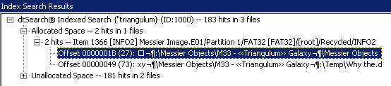
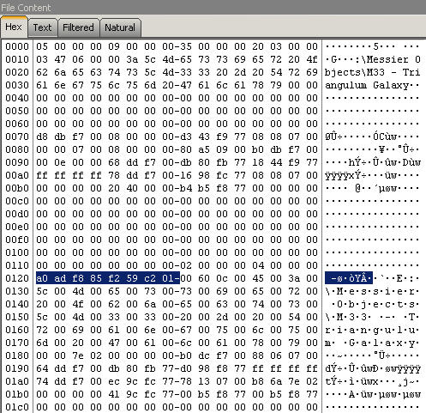

dtSearch Hits
Recognizing INFO2 hits…

Slide 22
Unallocated – Expression Hits
See any potential PATTERN search use here ?

Slide 23
Unallocated – Expression Hits
[\x02-\x19]\x00{3}.{7}\x01.{4}[c-z]\x00\:\x00\\

Slide 24
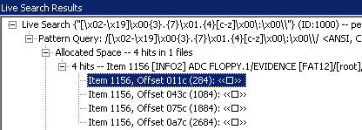
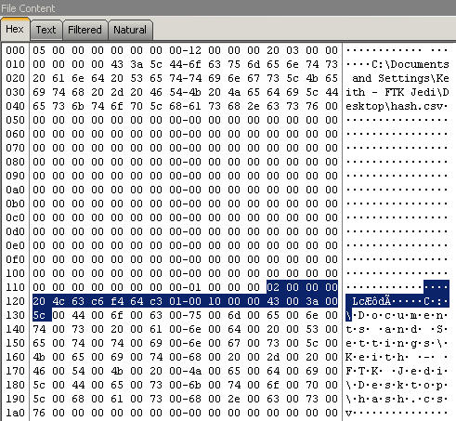
Expression Hits
Recognizing INFO2 hits

Slide 25
Module Review
Recycle Bin
  Functionality
  Folder and contents
  FAT vs. NTFS differences
INFO2 Structure
  “Deleted” file path
  “Deleted” file index number
  “Deleted” file drive location
  “Deleted” file date and time
  “Deleted” file physical size
Forensic Implications
  Files deleted or removed / emptied bin
  Recovering deleted INFO2 information

Slide 26



